Slide 1
The Challenge of History

Slide 2

The NAHSE Mission
OUR MISSION STATEMENT
The National Association of Health Services Executives (NAHSE) is a non-profit association of Black health care executives founded in 1968 for the purpose of promoting the advancement and development of Black health care leaders, and elevating the quality of health care services rendered to minority and underserved
communities.
NAHSE’s purpose is to ensure greater participation of minority groups in the health field. Its basic objective is to develop and maintain a strong viable national body to more effectively have input in the national health care delivery system. It has provided a vehicle for Blacks to effectively participate in the design, direction and delivery of quality health care to all people.
OUR VISION
NAHSE will be recognized globally as the premier professional membership society for Blacks in health care management. NAHSE strives to improve the health status, economic opportunities and educational advancement of the communities we serve. NAHSE is committed to the Association goals by providing: Professional Programs/Workshops, Educational Programs, A Job Bank, Mentoring Program, Scholarships, Fellowship Opportunities, Community Service Projects, Health Policy, and Expanding Business Contracting Opportunities.

Slide 3

The NAHSE Logo
Man/Woman standing (networking); Serpent and rod (health care access);
Lamp (wisdom/knowledge); Scroll and pen (writing/publication/learning). The pegs are the building blocks that support the organization. The pyramid has a base and points to all things that are important to NAHSE. The Cross is for protection and neutrality (consistent with the Red Cross and Johnson & Johnson symbol).

Slide 4
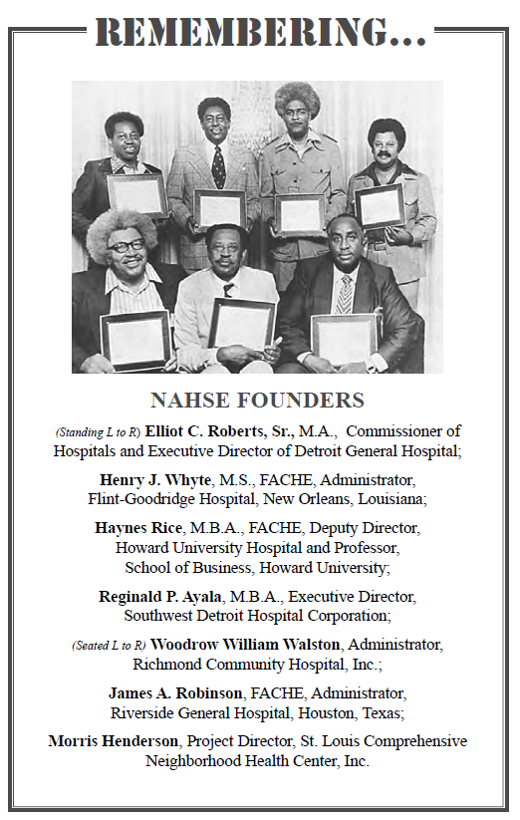
Where and in what year was NAHSE founded? What national meeting?
1968 in Atlantic City, NJ
American Hospital Association
Whitney Young, President of National Urban League, who made the connection that hospitals were the economic engines in communities

Slide 5
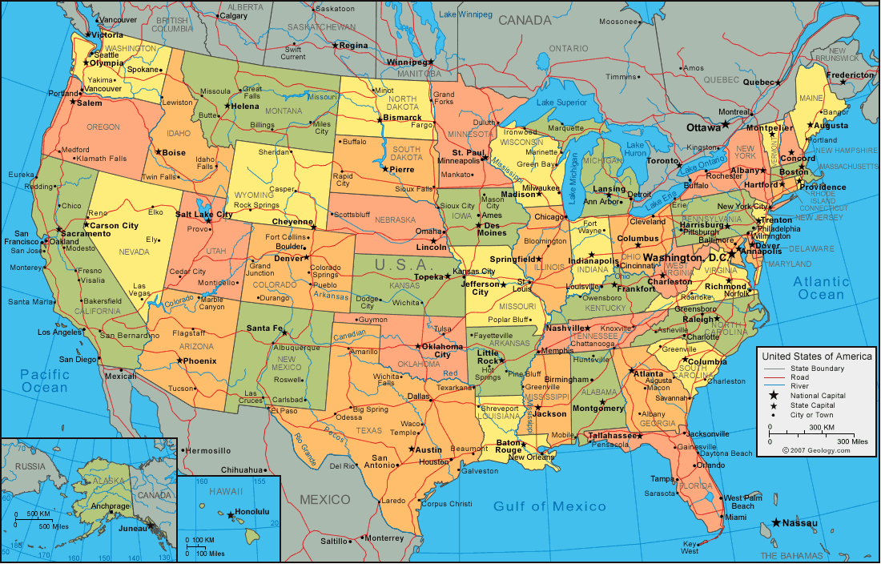
What were the original eight NAHSE Chapters (Prior to 1977)?
Chicago, Detroit, District of Columbia, Memphis, New York, Missouri/Kansas City, Virginia/Carolinas, Tennessee

Slide 6
In what year was the NAHSE logo developed?
1978 by Don Watson,
NAHSE President

Slide 7
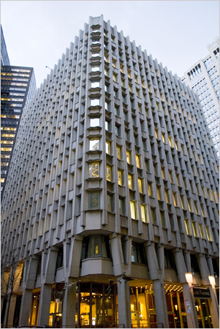
Where was NAHSE’s first headquarters?
BCBSA Building in NYC

Slide 8
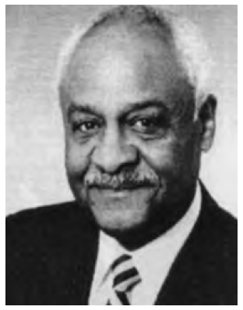

Who was the first NAHSE president?
Everett V. Fox,
Former Vice-President of
NYU Medical Center

Slide 9
What was the private term for females in NAHSE prior to 1985?
NAHSE-ettes,
whose function was to prepare cocktails, playing cards and keep the hospitality suite clean

Slide 10
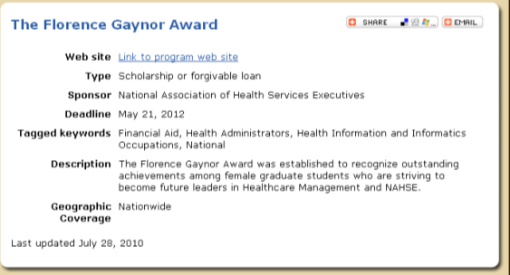
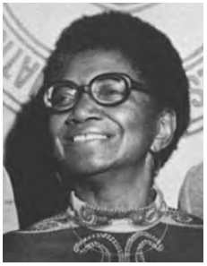
Who was the first female president of NAHSE?
Florence Gaynor, 1975
First Black female of an academic medical center in Newark, NJ; born in Jersey City, NJ
Nurse by training, MPH from NY University, studied at U of Oslo in Norway

Slide 11
What number President is
Fabian Stone?
#28

Slide 12
NAHSE Leadership 2021-2023
Deborah Lee-Eddie,
Chair
Herbert Buchanan
Chair-Elect
Lisa Mallory
Executive
Director

Slide 13
What was it that a 14-year-old said to Haynes Rice (one of the NAHSE founders) that shaped his views on forming NAHSE?
When will you Black people who have education help those of us who have little? What have you ever done for us?

Slide 14
The Losses we have experienced
Percy Allen, II, FACHE, President, 1991-1993
Sandra Gould, Ph.D. FACHE
President, 2001-2003
Bernard Tyson, President/CEO, Kaiser Permanente, NAHSE Sponsor

Slide 15
The Challenge
Nat Wesley (1980)
  NAHSE officers must be committed to professional leadership behavior, major goals and direction of the organization and translated into specific program, fiscal accountability, organizational recordkeeping, ongoing communication and responsiveness to the membership
Tom Dolan, Ph.D. (2007)
  There is a role on the national stage for NAHSE as long as its members continue to support its initiatives. The economy, employment dislocations, personal time constraints and family commitments challenge the resources that individuals can devote to membership groups. The NAHSE value proposition with its members will be the key to its long-term survival
Richelle Webb Dixon (2018)
  This year we honor members who humbly work to fulfill our mission and highlight young professionals whose passion and intellect will propel NAHSE into the next-50 years. We must ensure that all individuals have access to affordable, quality, healthcare services. We must ensure NAHSE remains a relevant resource for generations to come.

Slide 16


Slide 17
Thank You!
Questions?

